Slide 1
Blacktown Chinese Christian Church
Welcome to Our English Service
05.07.2026
English Service 9:45 – 11:00 am
Worship Songs:
Passage:
Speaker:
Topic:
Response Song:
Announcements and Closing Prayer
Benediction
My Labour is Not in Vain Jesus Strong and Kind Jerusalem
Eph 2:1-10
Jose Peter
Made Alive with Christ

Slide 2
BCCC english service

Slide 3
My Labour Is Not In Vain
CCLI Licence No: 5485849

Slide 4
My work in Christ is not in vain
My labor will not fail
For when I toil in Jesus’ name
His purpose will prevail

Slide 5
The tasks that You have set for me
I may not understand
Yet I will follow where You lead
I trust Your sovereign hand

Slide 6
So may all I do, be it great or small
Bring glory to Your name

Slide 7
In Your grace alone I will car – ry on
Your promise to me remains
My labour is not in vain

Slide 8
Go forth, You said, take up your cross
And set the captive free
So give me feet to seek the lost
Just as You searched for me

Slide 9
So may all I do, be it great or small
Bring glory to Your name

Slide 10
In Your grace alone I will car – ry on
Your promise to me remains
My labour is not in vain

Slide 11
Take heart, my soul, and persevere
Just as your Saviour did
For soon you will be home at rest
Your work, complete in Him

Slide 12
So may all I do, be it great or small
Bring glory to Your name

Slide 13
In Your grace alone I will car – ry on
Your promise to me remains
My labour is not in vain

Slide 14
So may all I do, be it great or small
Bring glory to Your name

Slide 15
In Your grace alone I will car – ry on
Your promise to me remains
My labour is not in vain

Slide 16
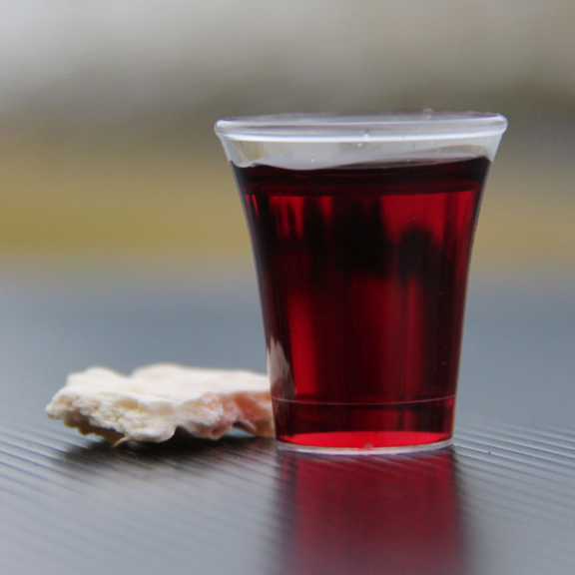
Holy Communion

Slide 17

Bible reading

Slide 18
Eph 2:1-10
As for you, you were dead in your transgressions and sins, ² in which you used to live when you followed the ways of this world and of the ruler of the kingdom of the air, the spirit who is now at work in those who are disobedient.

Slide 19
Eph 2:1-10
³ All of us also lived among them at one time, gratifying the cravings of our flesh and following its desires and thoughts. Like the rest, we were by nature deserving of wrath. ⁴ But because of his great love for us, God, who is rich in mercy,

Slide 20
Eph 2:1-10
⁵ made us alive with Christ even when we were dead in transgressions—it is by grace you have been saved. ⁶ And God raised us up with Christ and seated us with him in the heavenly realms in Christ Jesus,

Slide 21
Eph 2:1-10
⁷ in order that in the coming ages he might show the incomparable riches of his grace, expressed in his kindness to us in Christ Jesus. ⁸ For it is by grace you have been saved, through faith—and this is not from yourselves, it is the gift of God—

Slide 22
Eph 2:1-10
⁹ not by works, so that no one can boast. ¹⁰ For we are God’s handiwork, created in Christ Jesus to do good works, which God prepared in advance for us to do.

Slide 23
Announcements

Slide 24





Account name: Blacktown Chinese Christian Church
Account number: 4216 50263
Offering
BSB: 112 - 879
Please put in "offering" as the reference
The offering box is available at the back of the hall

Slide 25
Prayer points

Slide 26
Mingle time!

